Slide 1
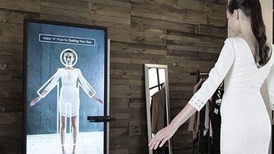
SMART BODY POSTURE RECOGNITION AND GUIDING SYSTEM

Slide 2
PEER MEMBERS:
ANTONY RAJ.M(15ITA01)
MANOJ.M(15ITA11)
PADMAJAA.B(15ITA17)
ACADEMIC GUIDE:
Mr.RAJASEKARAN.S (AP/IT)
INDUSTRY GUIDE:
Mr.HARI BALAKUMARAN

Slide 3
PROBLEM STATEMENT
To capture the hand gesture and check whether the hand is placed in the right gesture using image processing system.If the hand is in wrong gesture then arriving at accurate results are not possible.This problem is solved using smart body posture recognition.

Slide 4
ABSTRACT:
A gesture is a form of nonverbal communication or non vocal communication. Gestures include movement of the hands, face, or other parts of the body. Gestures allow individuals to communicate a variety of feelings and thoughts. Gesture processing takes place in areas of the brain such as Broca's and Wernicke's areas, which are used by speech and sign language. We provide a system that captures the image of the whole body and it recognizes the body posture of an individual and gives them the right posture for calculating the blood pressure through image processing.

Slide 5
BASE PAPER
This paper was published by Mr.Sagar, P.More, Prof.Abdul Sattar “Hand Gesture Recognition System Using Image Processing”(International Conference) published in 2016. Sign language is widely used by people who can’t speak and hear or people who can hear but can’t speak. A sign language is composed of various gestures formed by different hand shapes, movements and orientations of hands.But the use of these gestures are always limited in the deaf-dumb community, normal people never try to learn the sign language.
This paper was published by Meenakshi Panwar “Hand gesture recognition based on shape parameters”(International Conference) published in 2012 The approach introduced in this paper is totally depending on the shape parameters of the hand gesture. It does not consider any other mean of hand gesture recognition like skin color, texture because these image based features are extremely variant to different light conditions and other influences.

Slide 6
LITERATURE SURVEY
This paper was published by Noor Adnan Ibraheem , RafiqulZaman Khan “Survey on various gesture recognition techniques and technologies”(International Journal) published in 2012. Gestures considered as the most natural expressive way for communications between human and computers in virtual system. Hand gesture is a method of non-verbal communication for human beings for its freer expressions much more other than body parts.
This paper was published by Ankit chaudhary, J.L. Raheja, Karen Das and Sonia Raheja “Survey on hand gesture recognition in context of soft computing”(Conference) published in 2010.In this paper we are discussing work done in the area of hand gesture recognition where focus is on the soft computing based methods like artificial neural network, fuzzy logic, genetic algorithms, etc. We also de-scribed hand detection methods in the preprocessed image for detecting the hand image

Slide 7
LITERATURE SURVEY (CONTD)
In this paper by Neethu P S , Dr. R. Suguna “A Survey on hand gesture recognition system”(International Journal) Published in 2016. Gesture recognition can be seen as a way for computers to begin to understand human body language, thus building a richer bridge between machines and humans than primitive text user interfaces or even GUIs.which still limit the majority of input to keyboard and mouse. In this paper, we provide a review on the hand gesture recognition including segmentation; feature extraction and classification methods are discussed.

Slide 8
MODULES
Welcome Module
Posture Module
Result Module

Slide 9
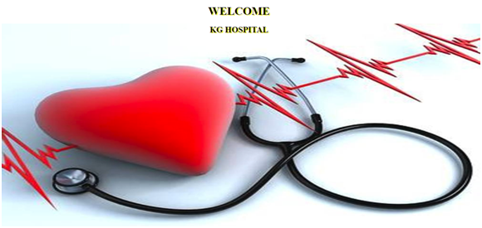
INTERFACE

Slide 10
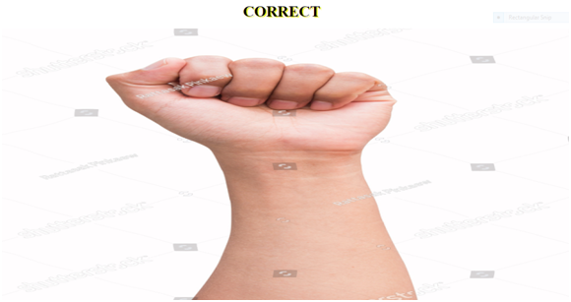

Slide 11
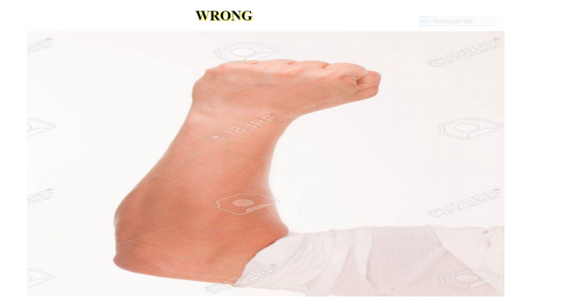

Slide 12
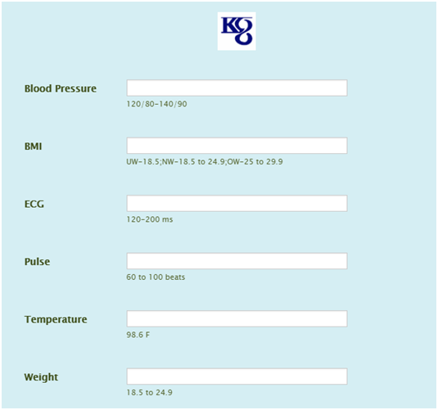

Slide 13
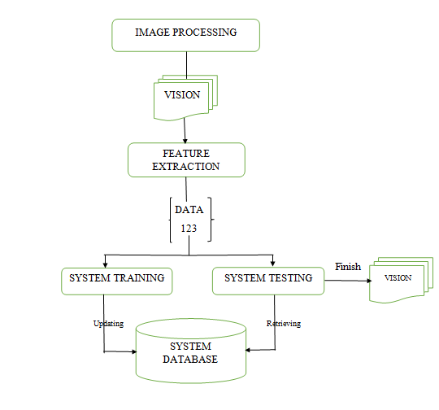
ARCHITECTURE DIAGRAM

Slide 14
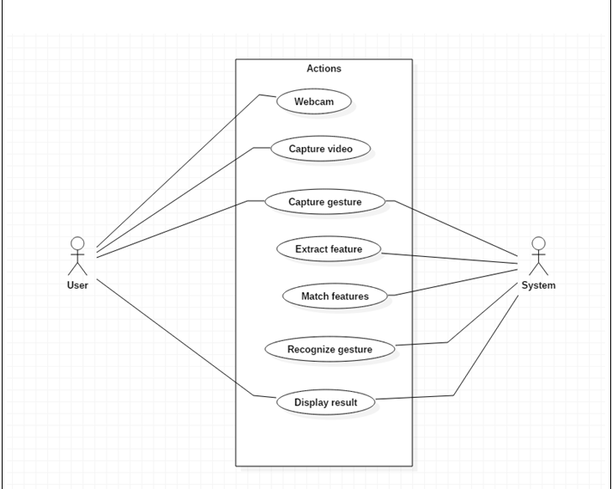
USE CASE DIAGRAM

Slide 15
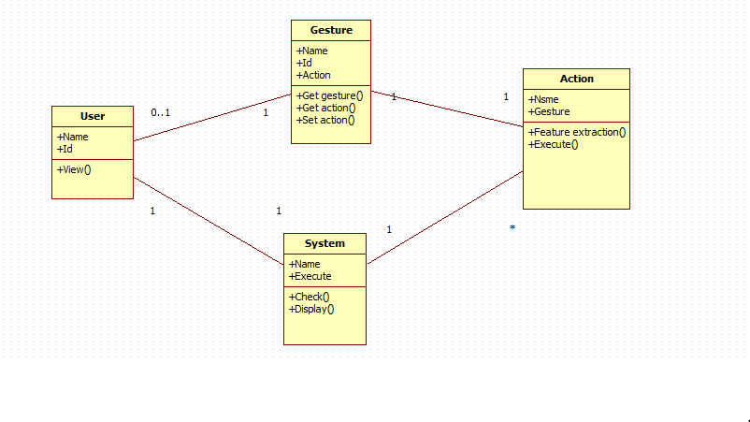
CLASS DIAGRAM

Slide 16
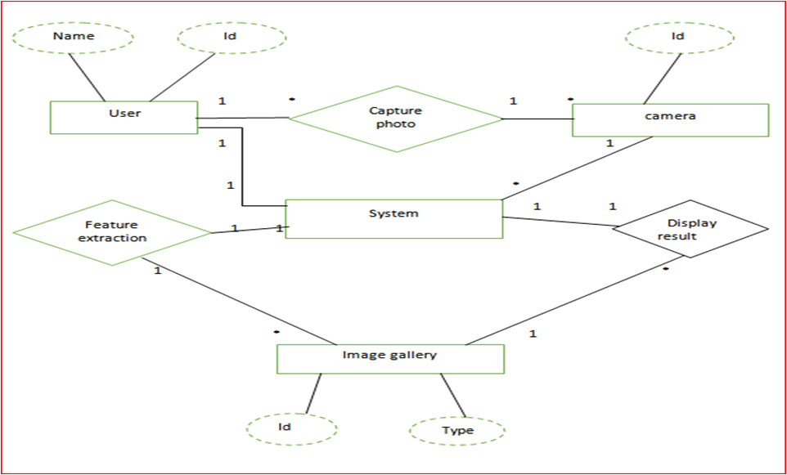
ER DIAGRAM

Slide 17
REQUIREMENT ANALYSIS FOR EACH MODULE
Welcome module:
User knows the details .
Posture module:
Checking gesture.
Result module:
Display the result to user.

Slide 18
CONCLUSION
Thus,these modules are user friendly for the users and guide them for having the correct gesture so that the medical diagnosis becomes easier.

Slide 19
QUESTIONS?

Slide 20
THANK YOU

